Slide 1
Emotional Intelligence & Emotional Control: Keys to Workplace Success
Enhancing Employee Performance Through Emotional Awareness & Self-Regulation

Slide 2
Objectives
1. Understanding Emotional Intelligence (EI) & Emotional Control (EC):
Defining both concepts and explore their significance.
2. Highlighting Their Importance in the Workplace:
Explaining how EI and EC contribute to professional success.
3. Enhancing Employee Relationships:
Emphasis how EI and EC foster better teamwork, communication, and collaboration.

Slide 3
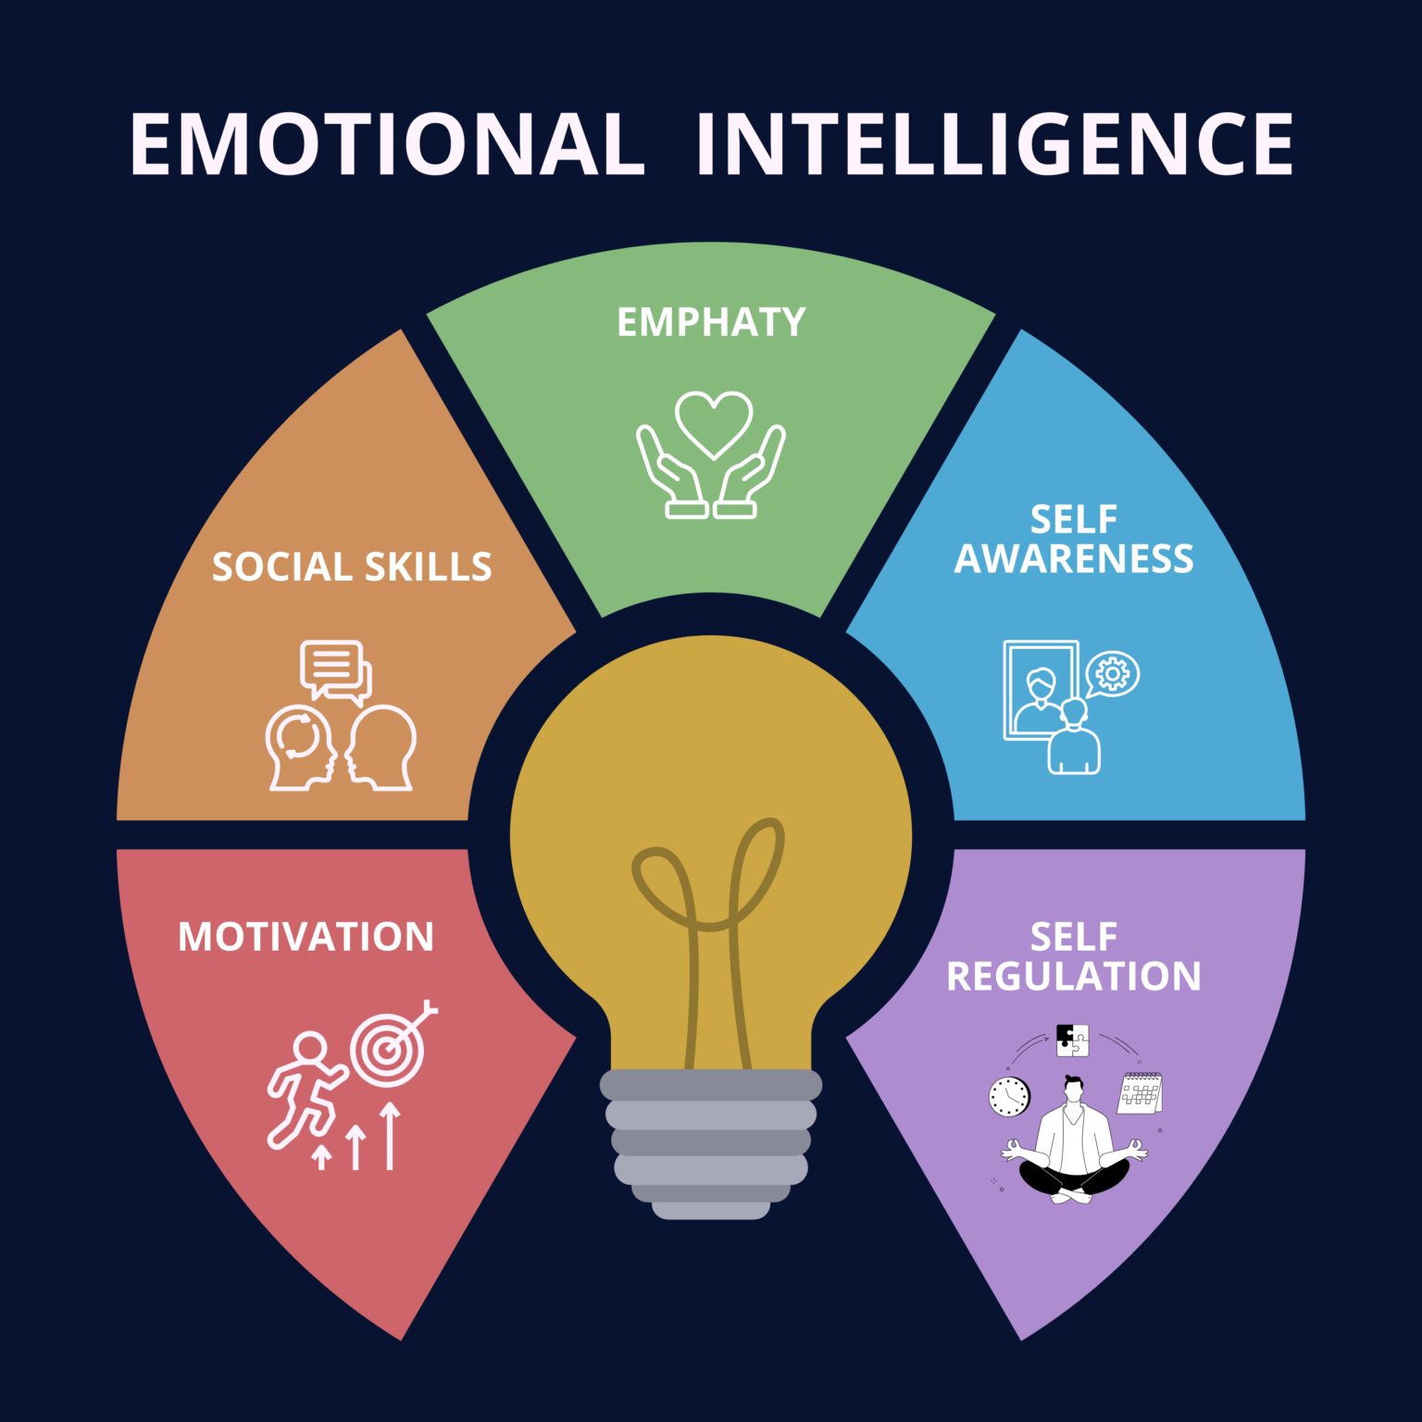
Emotional Intelligence (EI) & Emotional Control (EC)
The Five Components of Emotional Intelligence:
Motivation
Social Skills
Empathy
Self-Awareness
Self Regulation

Slide 4
Emotional Intelligence (EI) & Emotional Control (EC)
The Five Components of Emotional Intelligence:
Why the Light Bulb Symbol:
The central light bulb represents how these five components work together to create emotional "intelligence" - just like a light bulb illuminates a room, emotional intelligence illuminates our understanding of human interactions and helps us navigate workplace relationships more effectively.

Slide 5

Emotional Intelligence (EI) & Emotional Control (EC)
Emotional Control
The ability to manage, regulate, and direct your emotional responses in appropriate ways, especially during challenging or stressful situations. It's about choosing how to respond rather than reacting impulsively.

Slide 6

Emotional Intelligence (EI) & Emotional Control (EC)
Key Differences
Emotional intelligence is about understanding emotions (yours and others').
Emotional control is specifically about managing and directing your emotional responses.

Slide 7
Emotional Intelligence (EI) & Emotional Control (EC)
What Is Emotional Intelligence? | Business: Explained

Slide 8

How EI & EC Drive Professional Success?
Key advantages:
Enhanced Decision-Making & Problem-Solving.
Accelerated Career Advancement.
Stronger Workplace Relationships & Communication.
Improved Performance & Adaptability.
Measurable Impact on Success.
Competitive Professional Edge.

Slide 9

How EI & EC Transform Employee Relationships?
Key advantages:
Building Trust Through Emotional Awareness.
Effective Conflict Resolution.
Enhanced Team Communication.
Collaborative Problem-Solving.
Creating Inclusive Work Environment.
Improved Feedback Culture.
Stronger Cross-Functional Partnerships.
Positive Workplace Atmosphere.

Slide 10
Conclusion
1. EI and EC are essential career skills that will set you apart as interns and future professionals, helping you navigate workplace challenges, build stronger relationships, and accelerate your career growth.
2. Every workplace interaction is a chance to practice these skills - from handling feedback to collaborating on projects, you're building emotional competencies that will define your long-term professional success.
3. These skills improve with practice and reflection, so stay self-aware, learn from challenging situations, and remember that your ability to understand and connect with others will become increasingly valuable throughout your career.

Slide 11
Nisanth Saravanan

